Slide 1




Apache Footwear India Private Limited
The Prototype for
Cutting Material Management
Report Presented
Presented by : Manohar-G ( APC-IT )
2025 July 10

Slide 2

Organizational Workflow for Cutting Material Monitoring
Data Capture
BOM
Provides base material requirements.
Cutting Material Report
Input purchase data
Issue materials, verify stock
Purchase Team
Warehouse Team
Track Purchase Status
Warehouse stock data
Production
Check assigned POs start cutting only if fully ready escalate
Ensure BOM is accurate
validate material need
resolve errors
Track PO-wise readiness
material issues
escalate to teams
Planning Team
Plant In-charge
Line Supervisor
shares
Assigns
Top
Management
Sees high-level overview
View overall readiness %
material trends
escalations
Top Management
Cutting Material Report auto-syncs BOM,PURCHASE, WAREHOUSE, PLANNING AND PO DATA| Triggers alerts and tracks material readiness

Slide 3
Data Connectivity for Cutting Material Report
Data Transform From SAP to Oracle
SAP System
FMS – ETL Process
Oracle Database
Cutting Material Management Report
Data Flow
FMS runs automatically at a defined time (e.g., Before 11:30 PM daily).
Extracts relevant data (Done Cutting materials) from SAP using T-Code.
Transforms and pushes the data to Oracle DB tables
SAP to Oracle ( Via FMS )
Backend (C# API) queries relevant Oracle tables.
Applies any required business logic (e.g., grouping, filtering, validation).
Oracle to Backend
API exposes endpoints for the Vue.js frontend to consume.
/api/materials/done-cutting.
Supports filtering by date, batch, material type, etc.
Backend to Frontend
Dashboards / Reports showing Done Cutting data.
Features: filtering, searching, exporting to Excel/PDF, pagination
Frontend Vue.js

Slide 4
Track Material Process flow in SAP
The Material information for SO ( 1000241164 ) from SAP.
Sales Order | Order Quantity | Material | BOM Dosage Qty | PURCHASE Quantity | FETCHING Quantity | WAREHOUSE COMPONENT STOCK | Material Used In Production
1000241164 | 234 | 3100109815 | 18.868 | 193.678 | 18.868 | 18.868 | TRUE
 |  | 3100169880 | 2.099 | 21.201 | 2.104 | 2.104 | TRUE
 |  | 4010201784 | 277.43972 | 1,415.70 | 139.658 | 139.658 | TRUE
 |  | 4010400004 | 96.13403 | 510.488 | 51.704 | 51.704 | TRUE
 |  | 4020100305 | 0.8481 | 8.648 | 0.853 | 0.853 | TRUE
 |  | 4020109418 | 2.466 | 25.131 | 2.471 | 2.471 | TRUE
 |  | 4030800019 | 4.1808 | 42.333 | 4.184 | 4.184 | TRUE
 |  | 4040300029 | 468 | No Purchase Data | No Fetching Data | No Data | TRUE
 |  | 4040402608 | 50 | No Purchase Data | No Fetching Data | No Data | TRUE
 |  | 4040403276 | 184 | No Purchase Data | No Fetching Data | No Data | TRUE
 |  | 4040600043 | 14.1904 | 142.619 | 14.201 | 28.723 | TRUE
 |  | 4040600041 | 28.7144 | 399 | 28.723 | 14.201 | TRUE

Slide 5
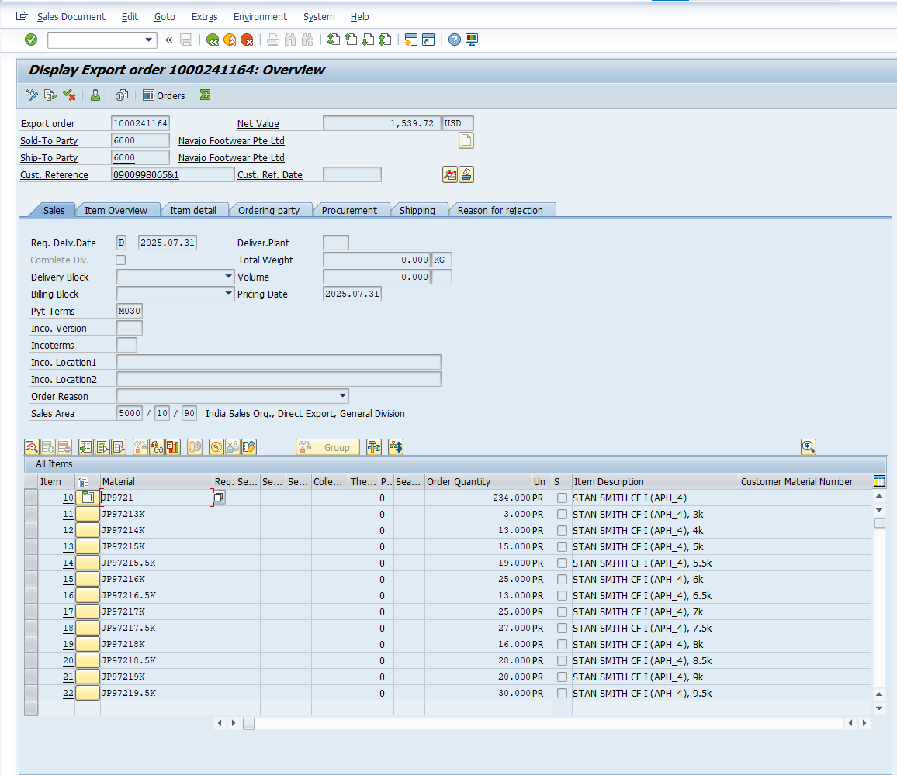
Sales Order Data Capture From SAP
This slide presents the extraction of key order information directly from SAP for reference and processing.
Displays the complete order overview, including customer information, and delivery details.
T-Code : VA03
SO Details :
Sales Order : 1000241164
Sales Order Total Quantity : 234
Material : 3100109815

Slide 6
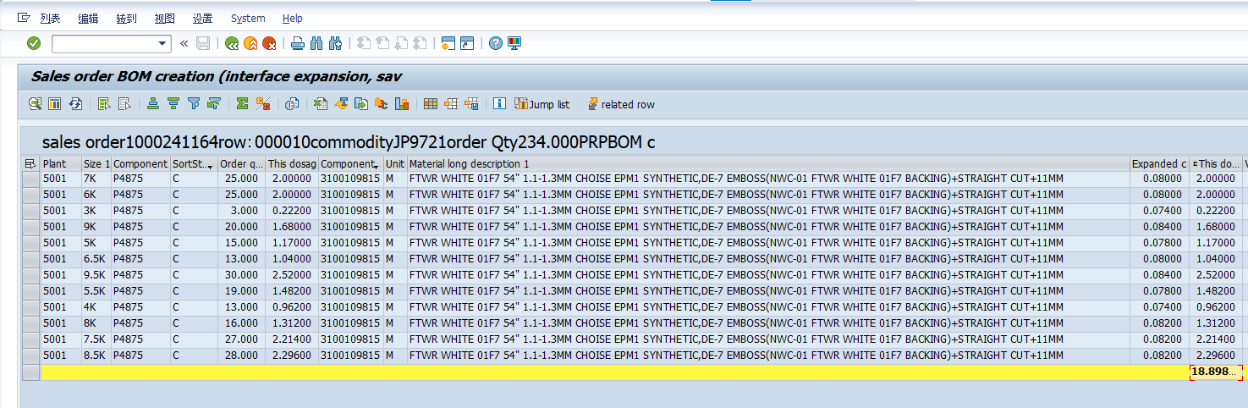
BOM Data Capture From SAP
This slide provides a summary of the total dosage quantity for one specific material.
Displays the complete BOM overview with total dosage quantity for cutting material only using the t-code ( ZMM123 )
SO Details :
Sales Order : 1000241164
Sales Order Total Quantity : 234
Material : 3100109815

Slide 7
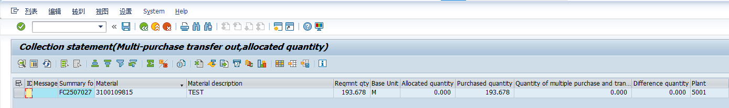
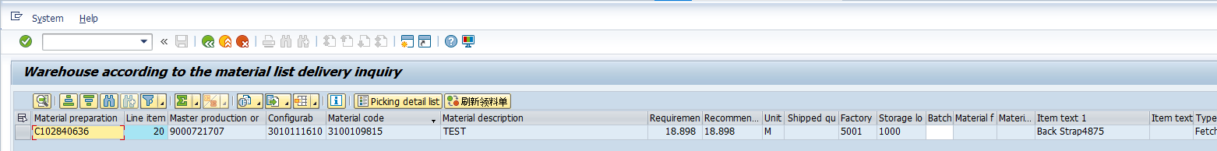
PURCHASE Data Capture From SAP
The Requirement quantity and allocated quantity and purchase quantity of material using t-code ( ZMM017_BB )
SO Details :
Sales Order : 1000241164
Sales Order Total Quantity : 234
Material : 3100109815
FETCHING Data Capture From SAP
The Fetching Details for material using t-code ( ZPP005B )
SO Details :
Sales Order : 1000241164
Sales Order Total Quantity : 234
Material : 3100109815

Slide 8
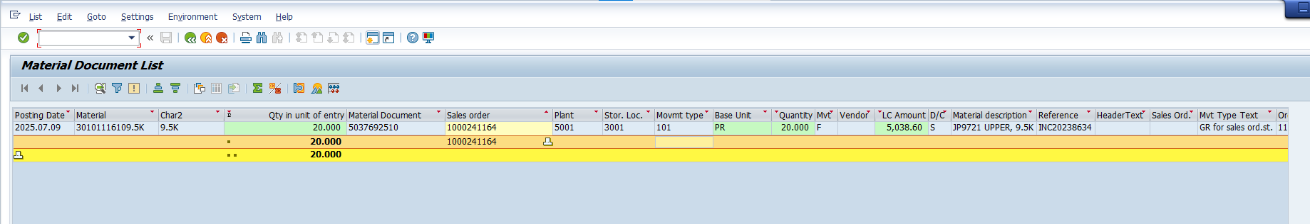
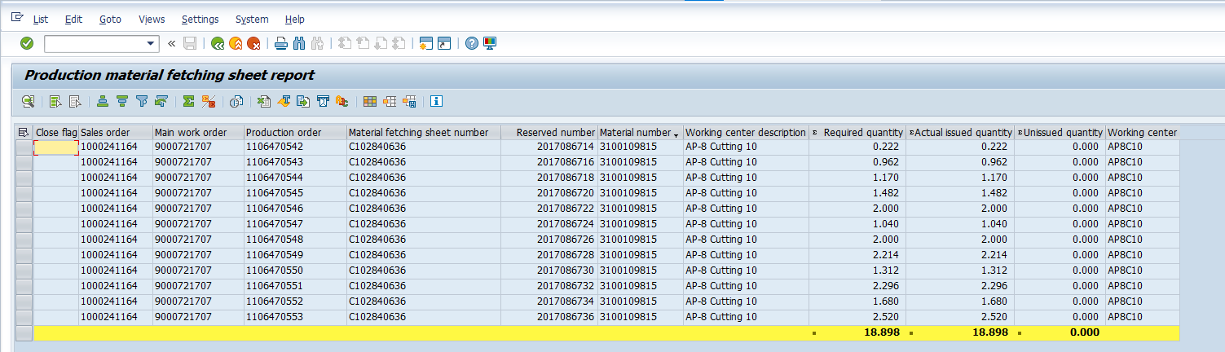
WAREHOUSE STOCK Data Capture From SAP
The warehouse stock for upper Material using the t-code ( MB51 )
The material information using the t-code ( ZMM113 )

Slide 9




